Slide 1
Jail-Break Bob
Goes To Space
Made in the Combustion Engine
Team Spaghetti and Meme-Balls : Antonio Cordeiro, Spencer Brereton, Herman Chung

Slide 2
Jail-Break Bob Goes To Space
-Penultimate installment of the Jail-Break Bob series (circa 2016)
-Other titles include: Jail-Break Bob, Jail-Break Bob Racing, Jail-Break Bob Mining Co., and the upcoming Jail-Break Bob Origins: Riot (Releasing April 26th, 2018 at 8:10am)
-Bob wants to escape it all and fly away into outer space
-The player navigates Bob’s spaceship through the asteroid belt after he escapes Earth
-The player can shoot the asteroids with lasers to gain points

Slide 3
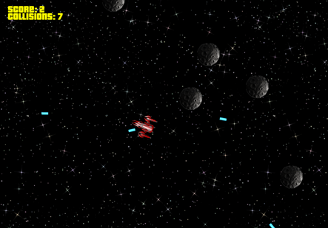

Slide 4
Reasons to use our engine
-Literally 0

Slide 5
Reasons to use our engine
-Easy-to-understand architecture
-Lightweight framework
-Very easy to achieve a high framerate with any project

Slide 6
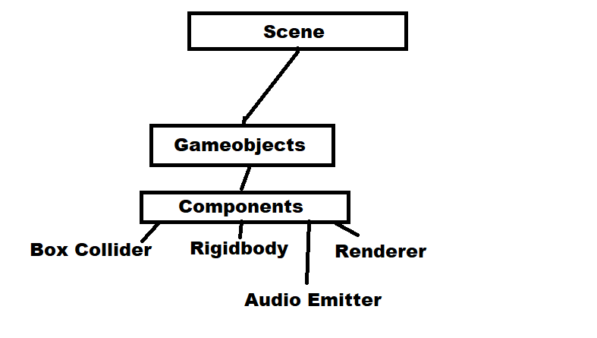

Slide 7
Game Loop
-Every frame, each GameObject…
-Handles Input
-Calculates Physics
-Updates its Components
-Draws

Slide 8
Custom GameObjects
-Player
-UI Label
-Audio Emitter
-Laser
-Asteroid
-Infinite Background

Slide 9
Other uses for this game engine
-Simple 2D games
-Pacman
-Snake
-Pong

